Slide 1
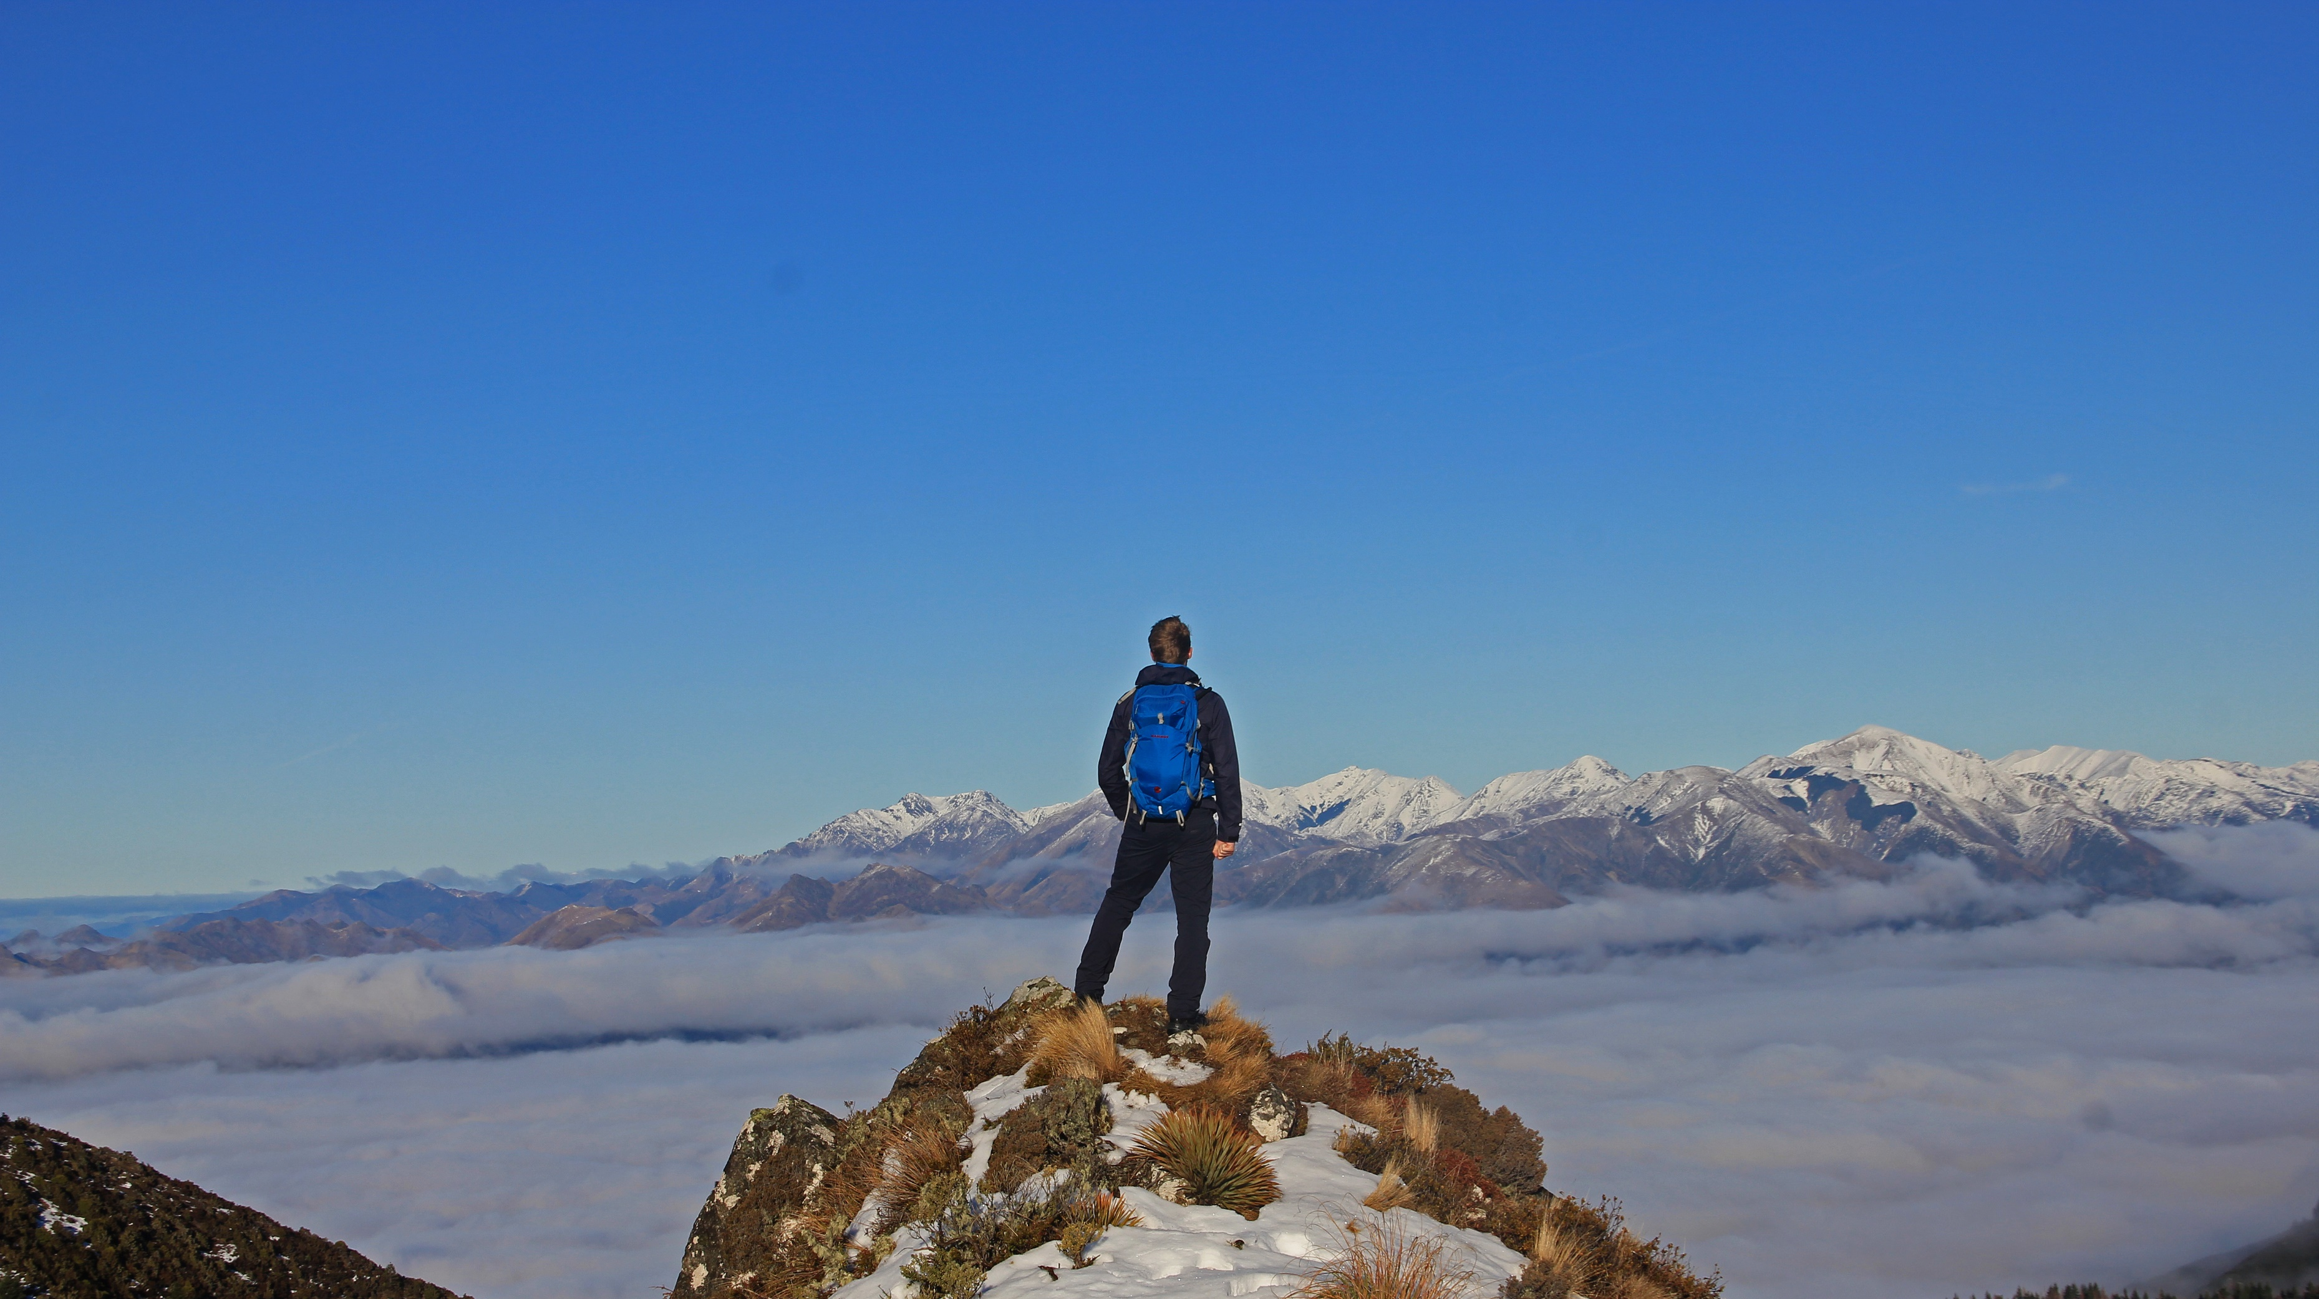

Conquer the world.
Plan your campaign today.
Notes:
Jan

Slide 2
Are you ready for (a) Perfect Time?
Perfect Time – Plan Your Trip
The planning tool for your perfect vacation

Slide 3
What to expect?
What is Perfect Time?
Why would you use Perfect Time?
Who created Perfect Time? How did the team organize itself?
What is the foundation of Perfect Time?
How was Perfect Time designed?
How is quality promoted and enforced?
What is the current state of the project?

Slide 4
What is Perfect Time? The vision and the idea
“Our vision is to create a web application that will allow you to plan your trip by setting different locations or stages. Afterwards you can publish your trip and share it with your friends. They can use your plan as an outline for their own trip by simply importing your published data.”
Make planning your trip simple, flexible and intuitive
Make sharing your experiences easy
Allow using experience of those who came before you

Slide 5
Why would you use Perfect Time? The customer benefit
UVP, there is no other application with similar functionality
Running as a web application in any browser and on any device
Customizable by the user
Easy to monetize by advertising activities, location or even whole trips.
Cheap to maintain and easily scalable

Slide 6
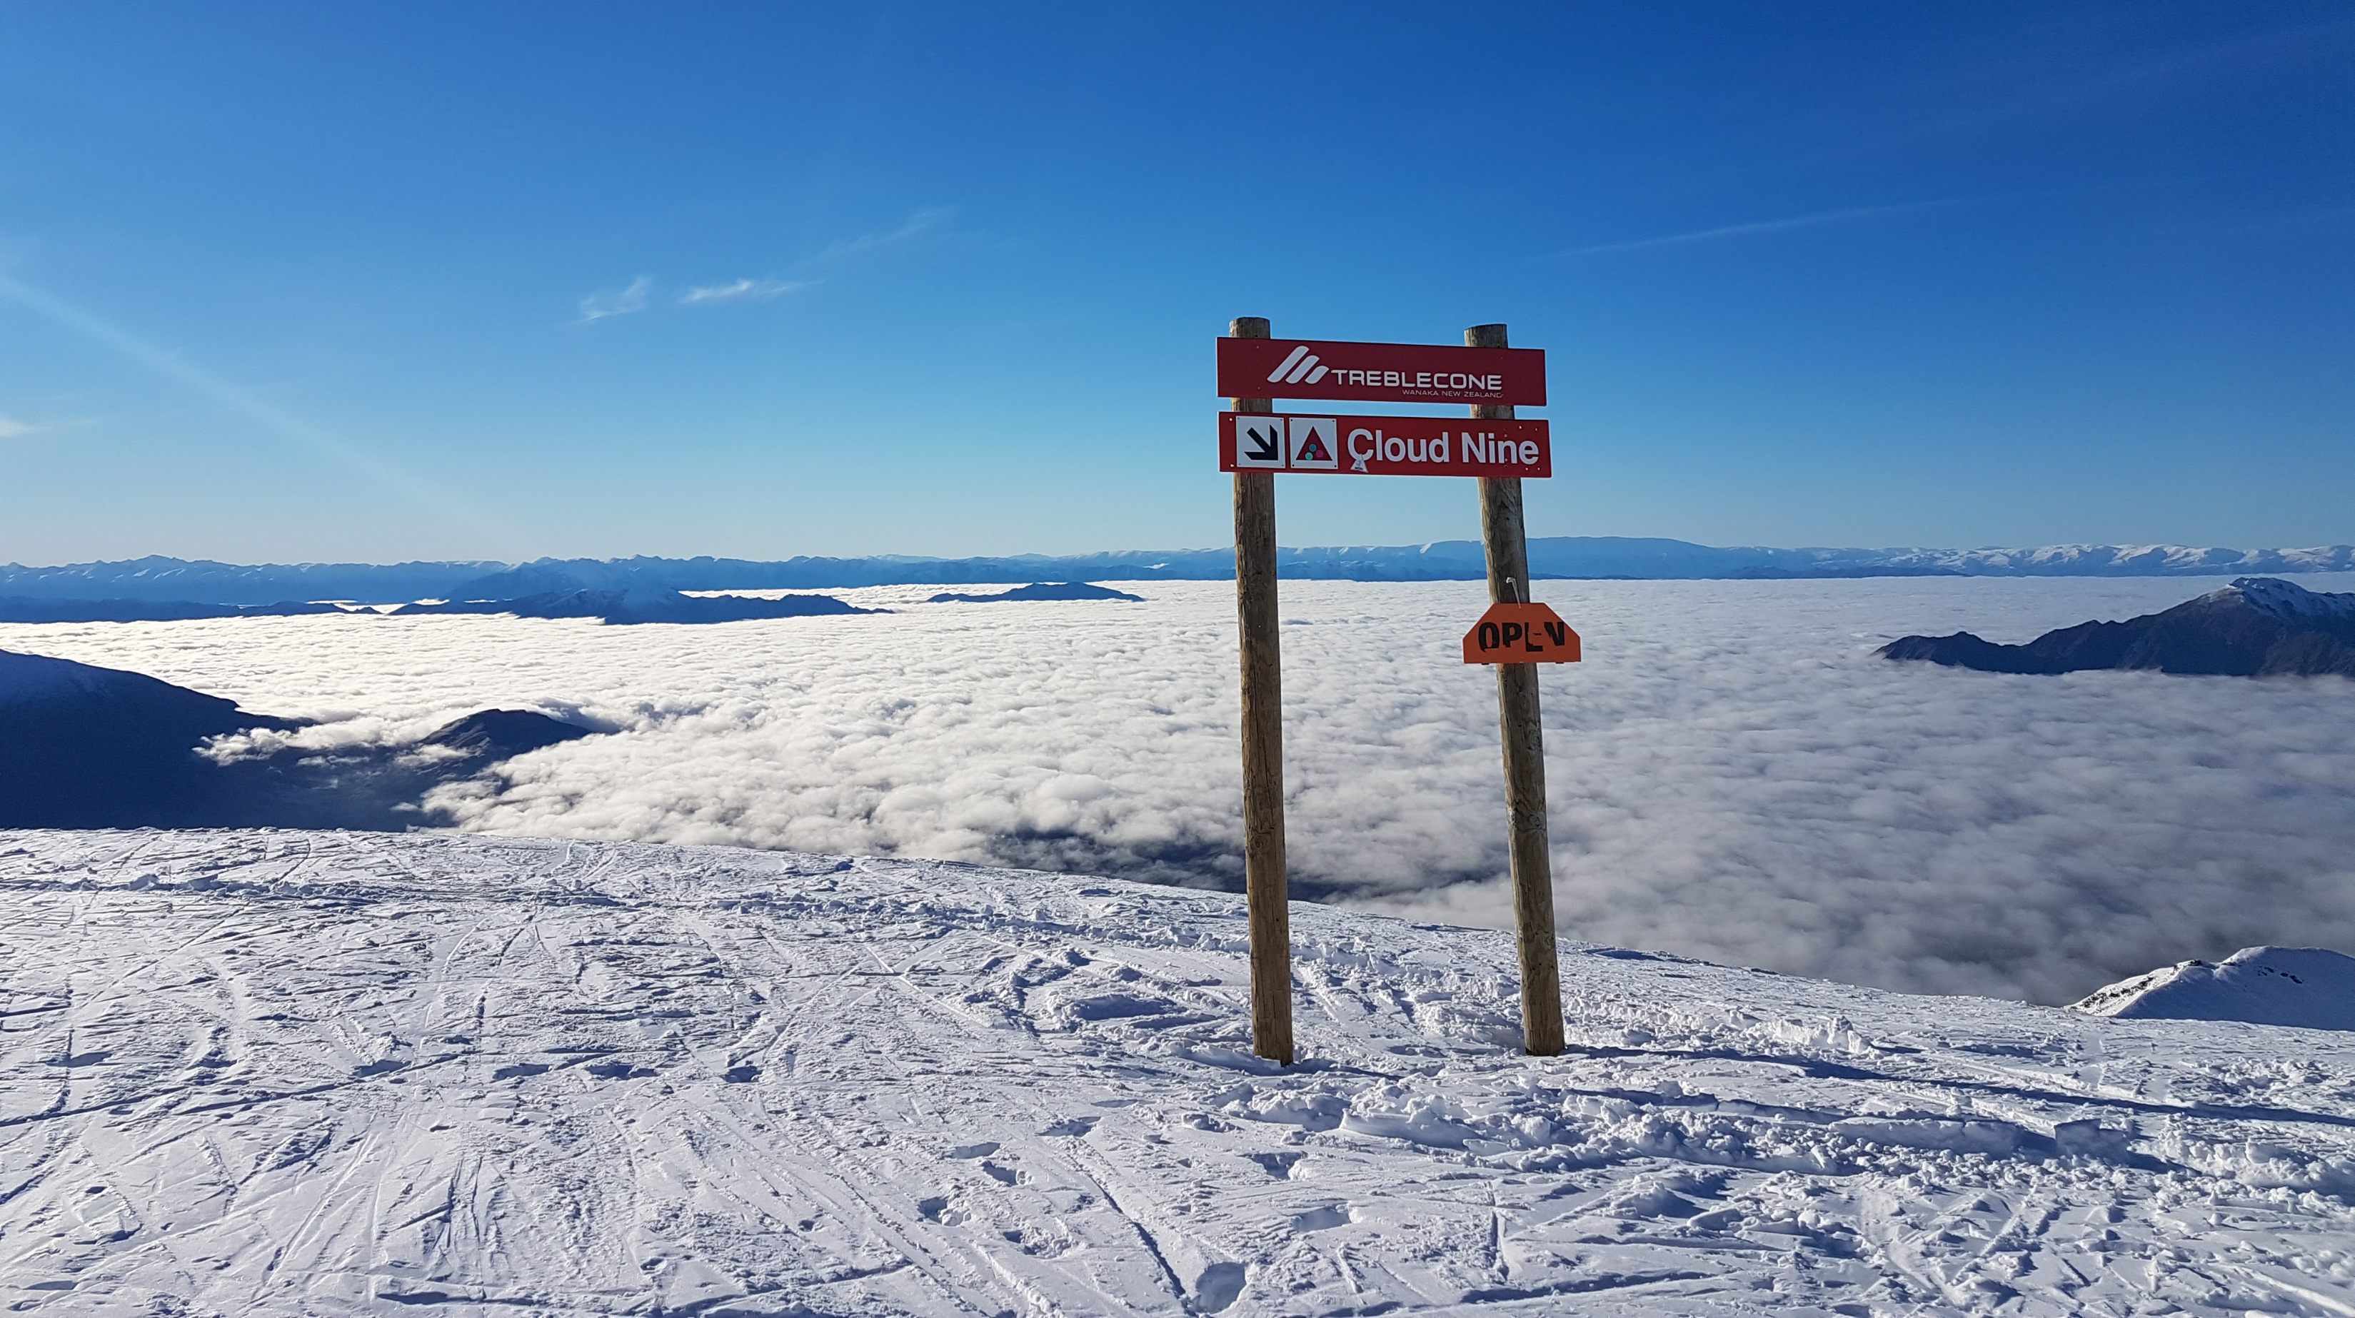
Plan your stay on Cloud Nine.
Notes:
Lukas

Slide 7
Who created Perfect Time? The team and the RUP roles
Jan: Systems Analyst, Tester
Lea: Business Process Analyst, Tester, Project Manager
Lukas: Software Architect, Tester, Deployment Manager
Tim: Integrator, Process Engineer

Slide 8
How did the team organize itself? Scrum and YouTrack
The project uses Scrum.
Agile -> Weeklong sprints
Clearly structured -> Swim lanes to organize tasks
Fast -> Breaking it down to small tasks
The progress can be accessed through our YouTrack account: https://perfecttime.myjetbrains.com/youtrack/agiles
We publish a weekly blog: https://perfecttime608150251.wordpress.com/

Slide 9
What is the foundation of Perfect Time? React, Firebase and Redux
React Web Application
Deployed on Google Firebase
NoSQL-database running on Firebase
Components synchronized with Redux

Slide 10

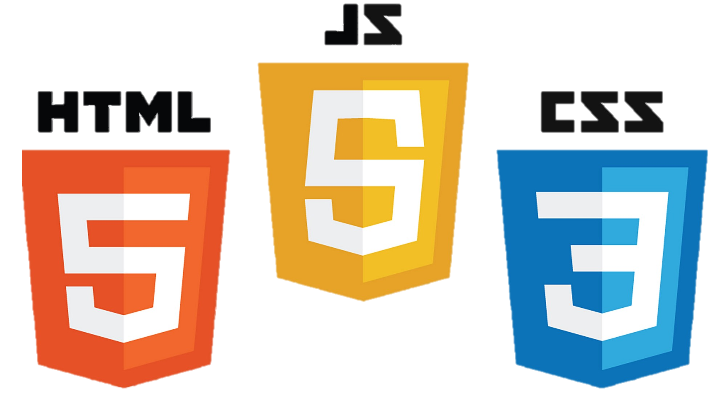








What is the foundation of Perfect Time? Tech Stack (I)
Frameworks / Dependencies
Languages
React
Redux
Firebase
Firestore (NoSQL)
Material UI
Node & NPM
HTML
CSS
JavaScript
TypeScript
YAML

Slide 11











What is the foundation of Perfect Time? Tech Stack (II)
Process & Documentation
Testing
Codacy
Codecov
Travis CI
GitHub
YouTrack
Wordpress
Jest
Faker
Cucumber
TestCafe
TSLint

Slide 12
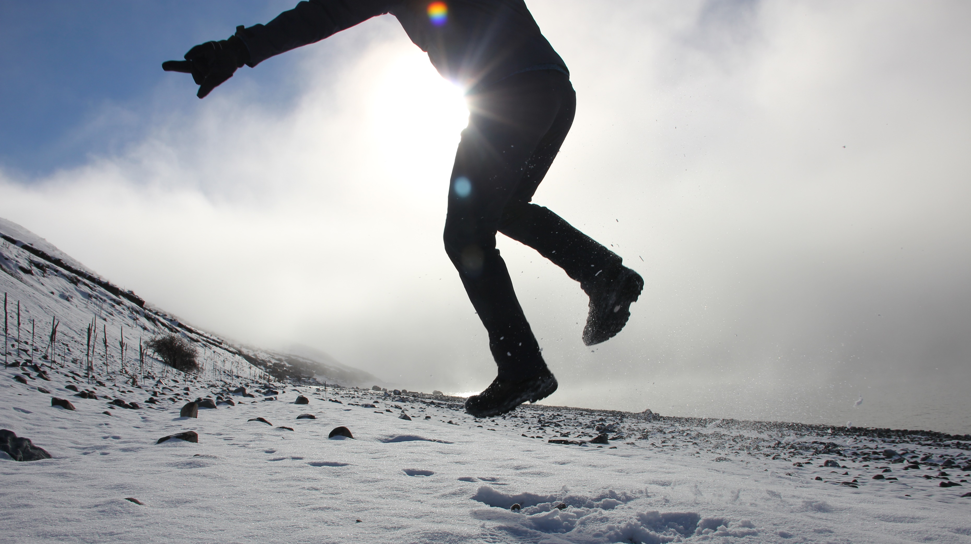
Find the place that makes your heart jump. Plan today.
Notes:
Tim

Slide 13
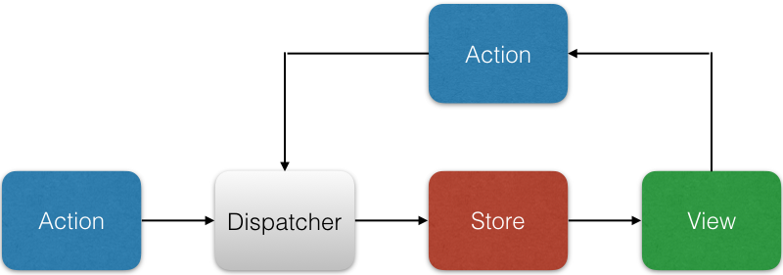
How was Perfect Time designed? React >> Flux architecture

Slide 14
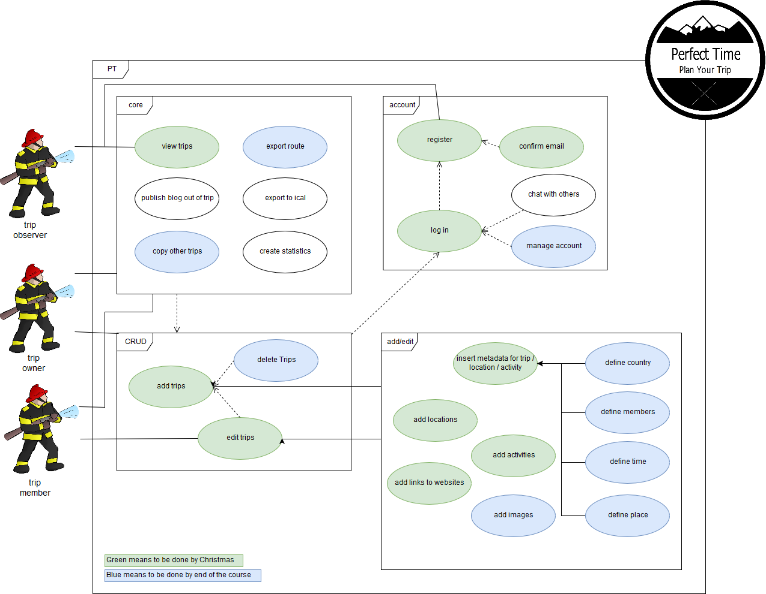
How was Perfect Time designed? Use Cases

Slide 15
How was Perfect Time designed? Use Cases

Slide 16
How was Perfect Time designed? Use Cases

Slide 17

Learn chilling from the pros.
Add the “activity“ today.
Notes:
Lea

Slide 18
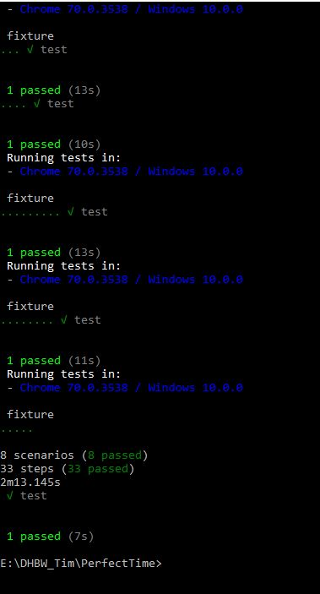
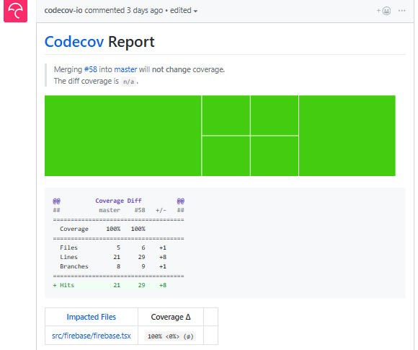
How is quality promoted and enforced? Merge Requests, Unit testing and Cucumber
Simple Rule: Merge through pull requests and test before you merge.
We use Cucumber JS and TestCafe to test the whole application.
This includes security testing.
We use Jest JS (unit) tests to assess our logic.
Test Coverage (Codecov): 100%

Slide 19
Live demonstration

Slide 20
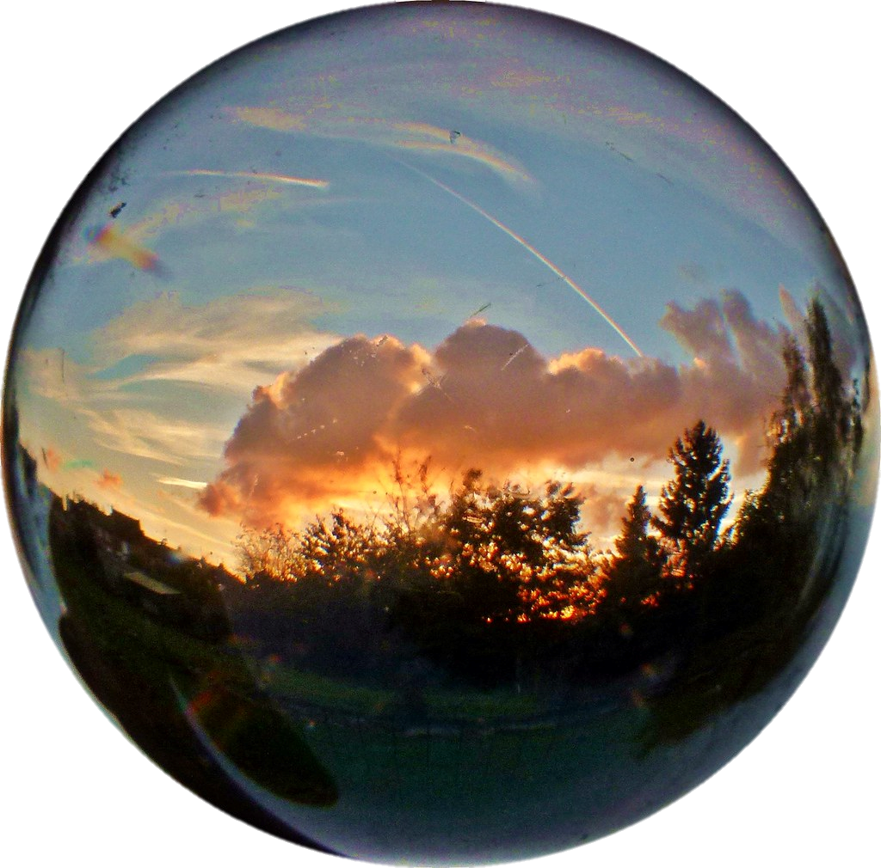
Peering into the crystal ball – Potential Add-ons
Turn trip into a blog
Fully customizable fields
Export / Import trip
Export to ical
Export route to Google maps
Groups, chat, newsfeed
Notes:
"Dieses Foto" von Unbekannter Autor ist lizenziert gemäß CC BY-SA-NC

Slide 21
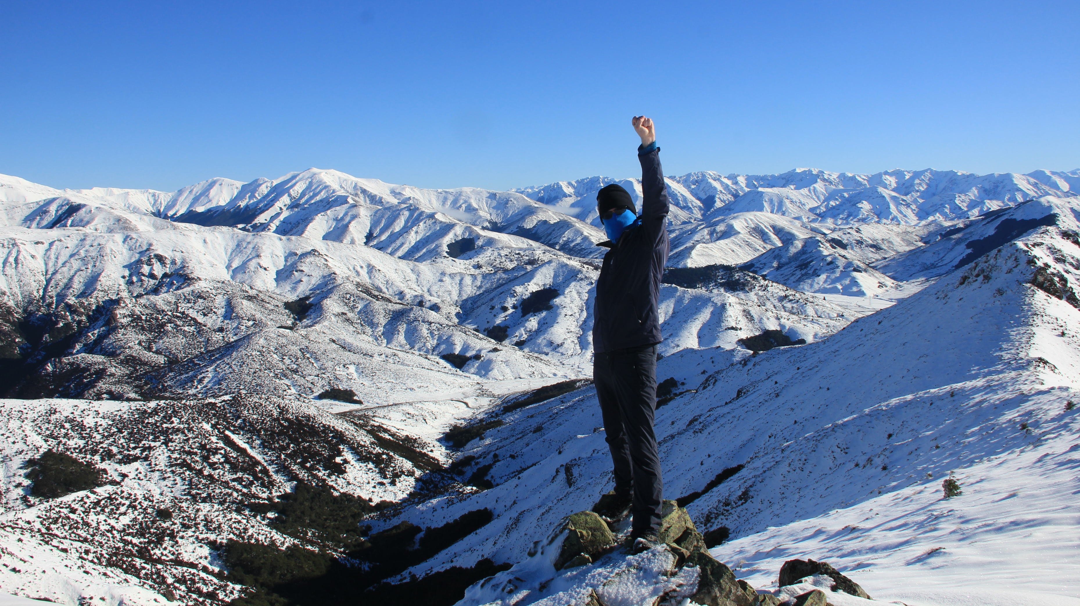
Make every time a Perfect Time.
Plan Your Trip today!

Slide 22
Thank you for your attention!
And have a Perfect Time.

